Slide 1
Ios workshop
MadE by PLT ios team ©2017

Slide 2
agenda
INTRODUCTION
CONSTRAINT ANATOMY
CONSTRAINTS in storyboard
Constraints in code
Size classes
Stack view

Slide 3
Introduction
What is auto layout?
Why DO we need it?
What are the benefits of using it?

Slide 4
INTRODUCTION
THE concept of auto layout
Auto Layout dynamically calculates the size and position of all the views in view hierarchy, based on constraints placed on those views.
This constraint-based design approach allows us to build user interfaces that dynamically respond to both internal and external changes.

Slide 5
INTRODUCTION
EXTERNal vs. internal changes
External changes occur when the size or shape of the superview changes
Internal changes occur when the size of the views or controls in user interface change.

Slide 6
INTRODUCTION
EXTERNAL CHANGES
Internal changes
Different screen sizes
Device rotation
The active call and audio recording bars (dis)appear
The content displayed by the app changes
Support for internationalization
Support for Dynamic Type
TXT

Slide 7
Introduction
Example 1
WORLD WITHOUT Auto layout

Slide 8
agenda
INTRODUCTION
CONSTRAINT ANATOMY
CONSTRAINTS in storyboard
Constraints in code
Size classes
Stack view

Slide 9
CONSTRAINT anatomy
Constraint components
Value (distance in points)
Relation (=, >=, <=)
Priority (0-1000)
Notes:
- Constraint kao objekat sa property-jima

Slide 10
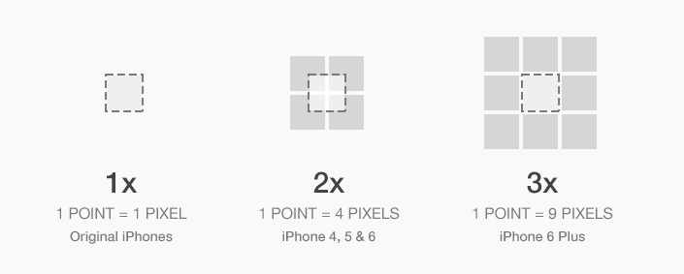
CONSTRAINT anatomy
POINT VS. PIXEL
One point does not necessarily correspond to one physical pixel

Slide 11
CONSTRAINT anatomy
What are constraints and auto layout actually?
auto layout is a series of linear equations
Each linear equation is represented by single constraints.
In runtime, those equation are solved in order to produce proper presentation of views.

Slide 12
CONSTRAINT anatomy
Constraint as linear equation
y = k∙x + n
BlueView.height = k∙GreenView.height + n

Slide 13
CONSTRAINT anatomy
EXAMPLE 2
Tweak Me

Slide 14
CONSTRAINT anatomy
HOW TO MAKE A CONSTRAINT?
In storyboard
Visual format language
NSLayoutConstraint API

Slide 15
agenda
INTRODUCTION
CONSTRAINT ANATOMY
CONSTRAINTS in storyboard
Constraints in code
Size classes
Stack view

Slide 16
CONSTRAINTS IN STORYboard
Adding constraints in storyboard
Preferred way for constraints manipulation
Instant preview available – easy to visualize
Little tricky to debug in runtime

Slide 17
CONSTRAINTS IN STORYboard
REVIEW & MODIFICATION OF CONSTRAINTS
Directly in storyboard
In document outline
In size inspector

Slide 18
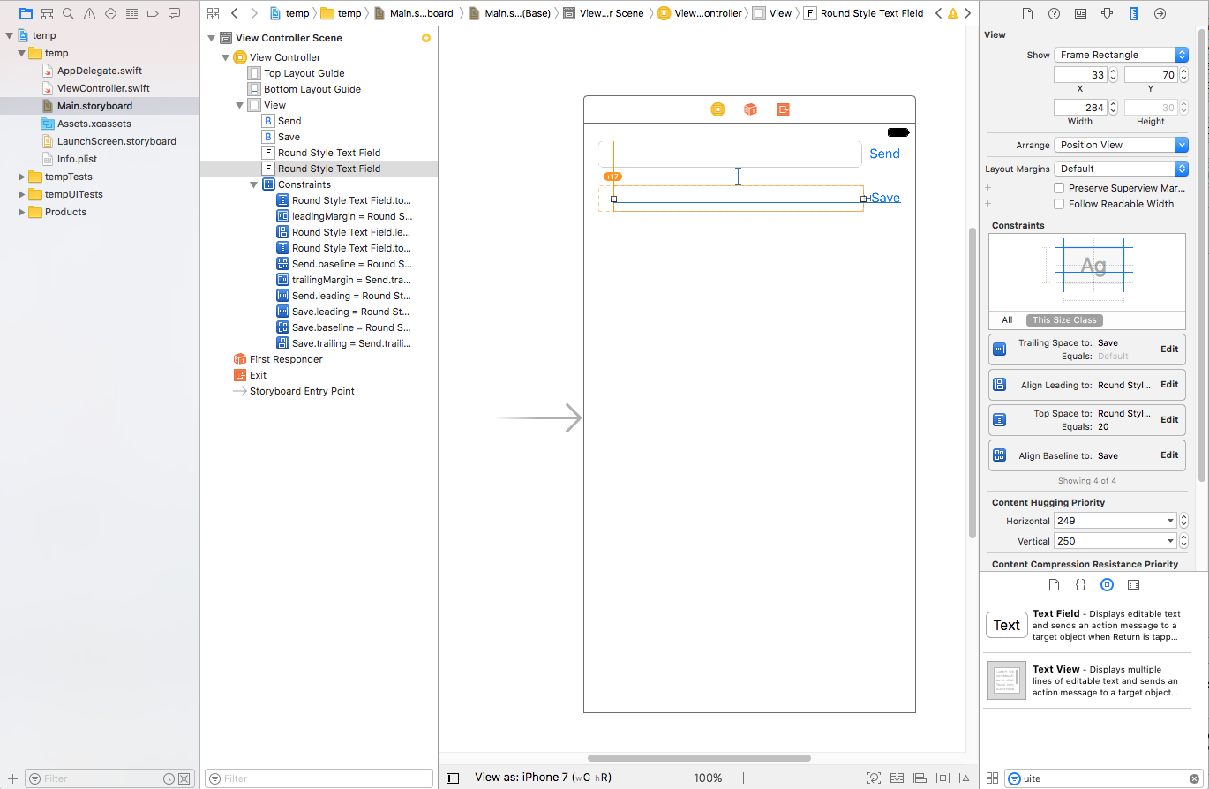
CONSTRAINTS IN STORYboard – XCODE IDE
Misplaced views indicator
Size Inspector
Constraint
Constraint
Constraint
Show Document Outline
Update Frames
Resolve
Stack
Allign
Pin

Slide 19
CONSTRAINTS IN STORYboard
EXAMPLE 3
LOG me in

Slide 20
CONSTRAINTS IN STORYboard
Content hugging & compression resistance
In case we can’t provide enough material for auto layout to work properly, content hugging properties will add additional missing info.
On the contrary, in case there’s not enough space to layout views, compression resistance properties will resolve auto layout issues.
Content hugging and compression resistance only impacts views with intrinsic* content size.
In order to satisfy auto layout rules, the views’ intrinsic content size can be even broken.
*Some views have a natural size given their current content. This is referred to as their intrinsic content size.

Slide 21
CONSTRAINTS IN STORYboard
Content hugging & compression resistance
Content hugging
Priority++ -> refuse to grow if there is free space
Compression resistance
Priority++ -> refuse to compress if there is not enough space

Slide 22
CONSTRAINTS IN STORYboard
EXAMPLE 4
Hug me, let me go

Slide 23
CONSTRAINTS IN STORYboard
Xcode tips&tricks part 1
Blue lines – these are your friends, not enemies
Use wisely reset to suggested constraints tool
Adding constraints in the document outline
Help yourself by naming constraints and views
Declare some view referent view and constraint other views to the referent one (make “relative” constraints, not the “absolute” ones)
Make some view “container” view and layout subviews inside it

Slide 24
CONSTRAINTS IN STORYboard
AUTO layout conflicts
Watch out for little red circle in document outline
Try to isolate the constraint causing the problem, don’t just pick everything Xcode suggests
Get familiar with constraint’s relation, priority and hugging/compression resistance

Slide 25
agenda
INTRODUCTION
CONSTRAINT ANATOMY
CONSTRAINTS in storyboard
Constraints in code
Size classes
Stack view

Slide 26
CONSTRAINTS IN CODE
WHY do we need to build constraints in code?
To add some complex constraints not possible to do in storyboard
To add constraints to view instantiated directly in code, not as outlets from storyboards (view doesn’t exist in storyboard)

Slide 27
CONSTRAINTS IN CODE
DARK SIDE OF IN CODE CONSTRAINTS
Writing over and over the same code
Cumbersome parts of code which contaminate already crowded view controllers (especially in MVC world)
Hard to visualize, no preview available (Playgrounds can help somehow)

Slide 28
CONSTRAINTS IN CODE
VISUAL FORMAT LANGUAGE
Auto Layout’s Visual Format Language (VFL) allows you to define constraints by using an ASCII-art formatted string
With a single line of code, you can specify multiple constraints in either the horizontal or vertical direction
Example:
H:|-[redView]-[blueView]-|
V:[blueView]-50-|

Slide 29
CONSTRAINTS IN CODE
VFL - SYMBOLS
H: horizontal direction
V: vertical direction
| superview
- standard spacing
-20- non standard spacing (20 points)
<= less than or equal to
>= greater than or equal to
@250 priority of the constraint (0..1000)

Slide 30
CONSTRAINTS IN CODE
VFL - EXAMPLE
H:|-[icon(==iconDate)]-20-[iconLabel(120@250)]-20@750-[iconDate(>=50)]-|

Slide 31
CONSTRAINTS IN CODE
EXAMPLE 5
VFL EXAMPLE

Slide 32
CONSTRAINTS IN CODE
NSLAyoutconstraint api
Allow us to create in details a single constraint. We can tweak every aspect of the constraint
Constraint is simply created by creating instance of NSLayoutConstraint class.
Example:
let width = NSLayoutConstraint(item: logoView,
attribute: .width,
relatedBy: .equal,
toItem: self.view,
attribute: .width,
multiplier: 1,
constant: 0)

Slide 33
CONSTRAINTS IN CODE
EXAMPLE 6
NSLAYOUTCONSTRAINT API EXAMPLE

Slide 34
CONSTRAINTS IN CODE
Xcode tips&tricks part 2
Use symbolic breakpoint at UIViewAlertForUnsatisfiableConstraints
Use console to printout problematic constraint details:
po [[UIWindow keyWindow] _autolayoutTrace]
po [[viewAddress recursiveDescription]
po [[viewAddress superview] recursiveDescription]
Once again, help yourself by giving proper names for constraints and views (accessibilityIdentifier)

Slide 35
agenda
INTRODUCTION
CONSTRAINT ANATOMY
CONSTRAINTS in storyboard
Constraints in code
Size classes
Stack view

Slide 36
SIZE CLASSES
What are size classes?
Size classes are traits assigned to user interface elements, like scenes or views.
They provide a rough indication of the element’s size.

Slide 37
SIZE CLASSES
That’s nice, but how we can used it?
Sometimes rotating changes the geometry so drastically that auto layout is not enough. We need to reposition the views to make them fit properly.
Based on the traits, it possible to:
Install or uninstall a view
Install or uninstall a constraint
Set the value of selected attributes (e.g. fonts)

Slide 38
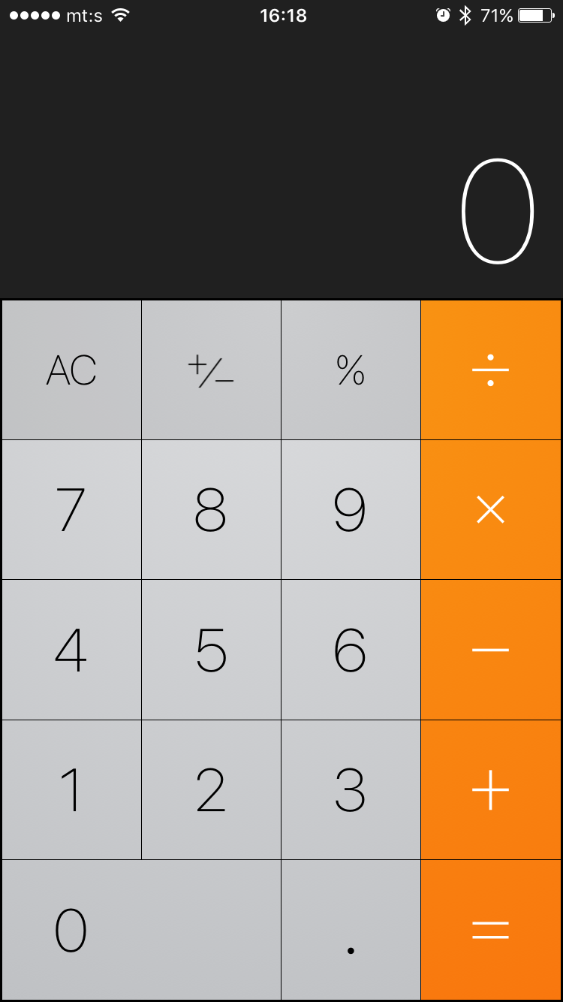
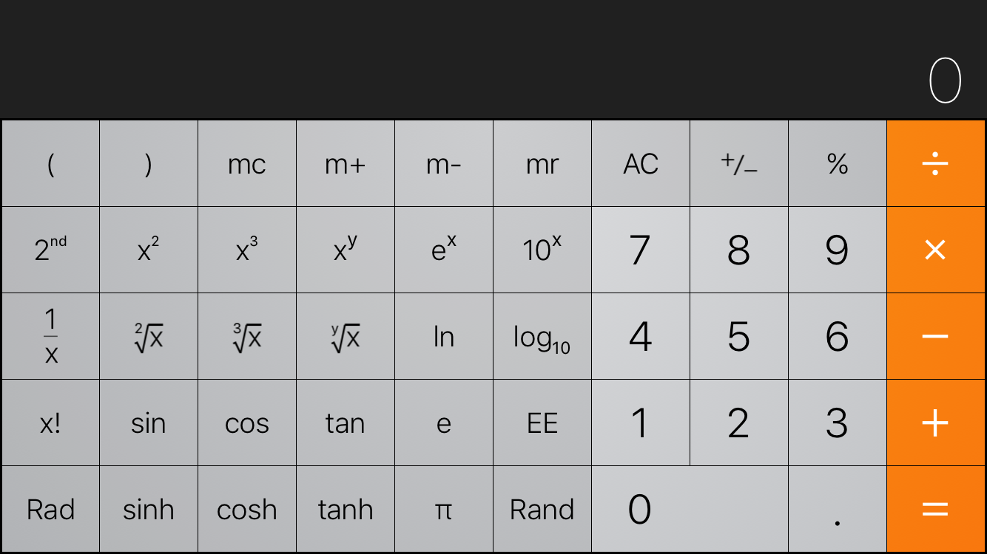
SIZE CLASSES
Additional part of UI showed only in specific screen sizes
Common part of UI
Common part of UI
Portrait
Landscape

Slide 39
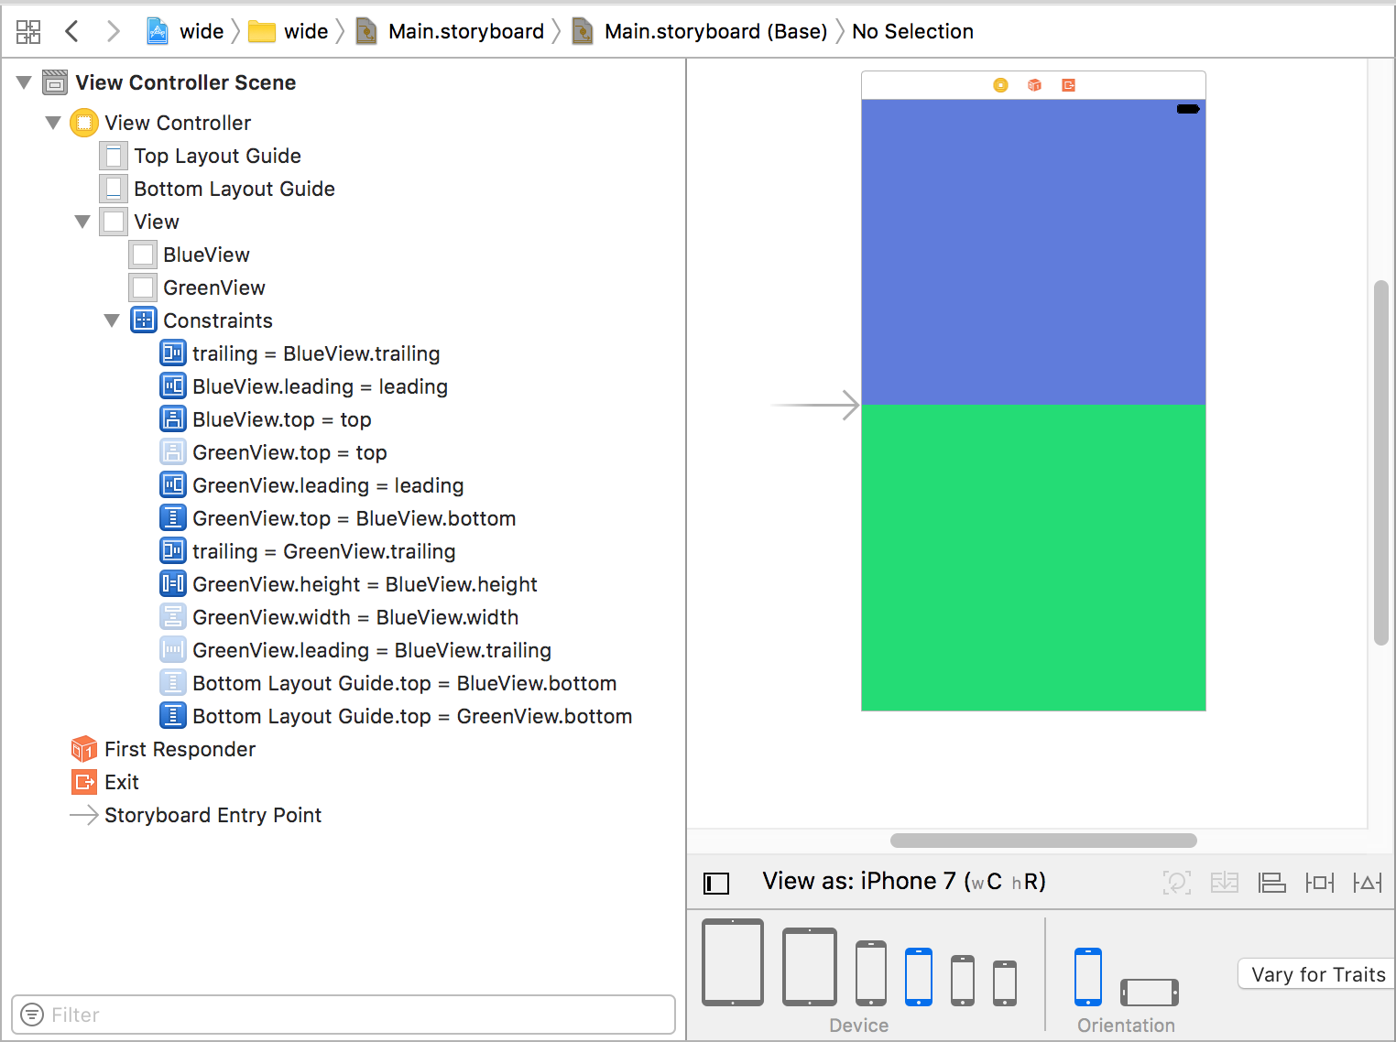
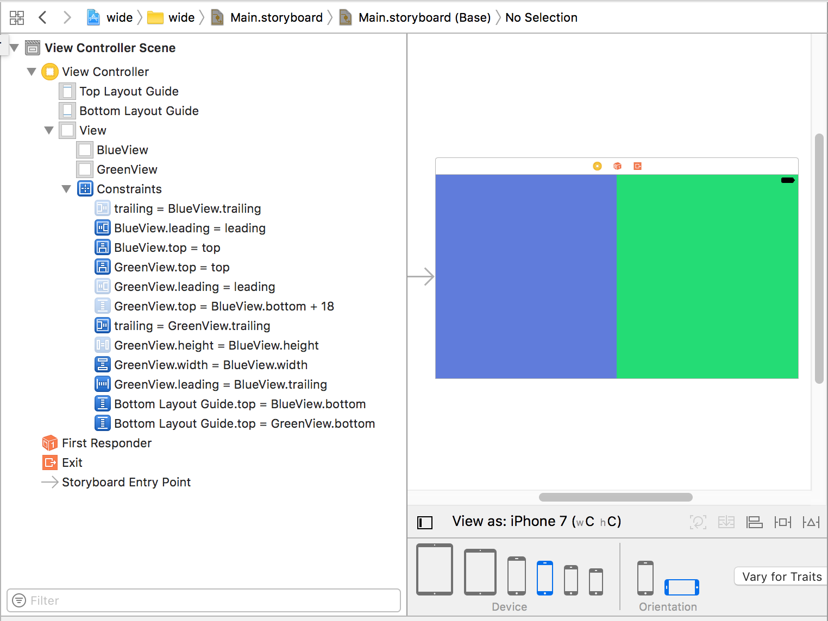
SIZE CLASSES
Set of enabled constraints is different in each orientation mode

Slide 40
SIZE CLASSES
SIZE CLASSES – VARIOUS DEVICES FULLSCREEN

Slide 41
SIZE CLASSES
How to find out running device screen size?
An MVC can find out its size class environment via this method in UIViewController:
let mySizeClass: UIUserInterfaceSizeClass = self.traitCollection.horizontalSizeClass
The return value is an enum .Compact or .Regular (or .Unspecified).
THIS APPLY TO ANY MVC, NOT JUST For full screen presented ONEs

Slide 42
SIZE CLASSES
EXAMPLE 7
I am tall…no wait, I am wide!

Slide 43
agenda
INTRODUCTION
CONSTRAINT ANATOMY
CONSTRAINTS in storyboard
Constraints in code
Size classes
Stack view

Slide 44
STACK view
What is STACK VIEW?
Why DO we need it?
What are the benefits of using it?

Slide 45
STACK VIEW
THE concept of STACK view
UIStackView behaves in predictable ways according to how autolayout works.
It allows us to easily layout and align UI elements in either vertical or horizontal direction.
It automatically builds those boring, repetitive, boiler plate constrains for us so we can be more relaxed and focused on UI design.

Slide 46
STACK VIEW
stack views - FACTS
Stack views can be nested, thus providing us a solution for complex UIs
Embedding any set of views the in stack view can be done in the storyboard
By combining horizontal and vertical stack views, a grid view can be achieved (sorry, there is no grid view for iOS yet)

Slide 47
STACK VIEW
STACK VIEW PROPERTIES
SPACING
Axis
Distribution
ALIGMENT
Spacing
Horizontal
Vertical
Fill
Fill Equally
Fill Proportionally
Equal Spacing
Equal Centering
Vertical
Fill
Leading
Center
Trailing
Horizontal
Fill
Top
Center
Bottom

Slide 48
STACK VIEW
Distribution Property
Fill makes one subview take up most of the space, while the others remain at their natural size. It decides which view to stretch by examining the content hugging priority for each of the subviews.
Fill Equally adjusts each subview so that it takes up equal amount of space in the stack view. All space will be used up
Fill Proportionally ensures subviews remain the same size relative to each other, but still stretches them to fit the available space.
Equal Spacing adjusts the spacing between subviews without resizing the subviews themselves
Equal Centering attempts to ensure the centers of each subview are equally spaced, irrespective of how far the edge of each subview is positioned
Notes:
Fill proportionally : - For example, if one view is 100 across and another is 200, and the stack view decides to stretch them to take up more space, the first view might stretch to 150 and the other to 300 – both going up by 50%.

Slide 49
STACK VIEW
EXAMPLE 8
CALCULATOR keyboard

Slide 50
RESOURCEs 1
Design Guidelines
https://developer.apple.com/ios/human-interface-guidelines/overview/design-principles/
Auto layout
https://www.appcoda.com/learnswift/auto-layout-intro.html
https://www.raywenderlich.com/115440/auto-layout-tutorial-in-ios-9-part-1-getting-started-2
https://www.raywenderlich.com/115444/auto-layout-tutorial-in-ios-9-part-2-constraints
https://developer.apple.com/videos/play/wwdc2016/236/
Stack view
https://developer.apple.com/library/content/documentation/UserExperience/Conceptual/AutolayoutPG/LayoutUsingStackViews.html#//apple_ref/doc/uid/TP40010853-CH11
https://www.raywenderlich.com/114552/uistackview-tutorial-introducing-stack-views
https://developer.apple.com/videos/play/wwdc2015/218/

Slide 51
RESOURCEs 2
Visual Format Language
https://www.raywenderlich.com/110393/auto-layout-visual-format-language-tutorial
https://developer.apple.com/library/content/documentation/UserExperience/Conceptual/AutolayoutPG/VisualFormatLanguage.html
Auto layout Debugging
https://developer.apple.com/library/content/documentation/UserExperience/Conceptual/AutolayoutPG/DebuggingTricksandTips.html
http://staxmanade.com/2015/06/debugging-ios-autolayout-issues/
http://nshint.io/blog/2015/08/17/autolayout-breakpoints/

Slide 52
RESOURCEs 3
Size Classes
https://makeapppie.com/2016/09/05/an-introduction-to-size-classes-for-xcode-8/

Slide 53
Petar Cvijić
iOS developer
petar.cvijic@endava.com

